Slide 1
Chest imaging
Lecture three
Dr. Marwa Majid aladhab

Slide 2
A 26-year-old woman with malaise and night sweats.

Slide 3
Objectives
Pulmonary collapse
Solitary pulmonary nodule
Multiple pulmonary nodules
Mediastinal mass
Hilar disorders
Pleural disorders

Slide 4
Pulmonary collapse
Either linear (discoid collapse) or more extensive involving pulmonary segment or lobe.
Causes of segmental or lobar collapse:
Bronchial obstruction
Passive collapse due to external pressure on the lung
Scarring or fibrosis
Notes:
Pulmonary collapse most commonly takes the form
of linear or disc-like areas of focal collapse, referred
to as linear or discoid atelectasis. Causes of linear
atelectasis include:
• Postoperative
• Inflammatory or other painful pathology
beneath the diaphragm, e.g. pancreatitis, acute
cholecystitis
• Pulmonary embolus
• Following resolution of pneumonia.

Slide 5
General signs of lobar collapse
Decreased volume of the affected lung
Displacement of pulmonary fissures
Local increase in density due to non-aerated lung
Elevation of ipsilateral hemidiaphragm
Displacement of hilum
Displacement of mediastinum towards side of collapse
Compensatory over inflation of adjacent lobes
Loss of visualization of anatomical structures: silhouette sign.

Slide 6
Location of pulmonary consolidation or collapse according to fissure abutment
Lobe of lung | Cause of straight margin
Rt upper lobe | Horizontal fissure inferiorly on PA film. Oblique fissure posteriorly on lateral film
Rt middle lobe | Horizontal fissure superiorly on PA film. Oblique fissure posteriorly on lateral film
Right lower lobe | Oblique fissure anteriorly on lateral film. Collapse causes rotation and visualization of the oblique fissure on the PA film
Left upper lobe | Oblique fissure posteriorly on lateral film
Left lower lobe | Oblique fissure anteriorly on lateral film. Collapse causes rotation and visualization of the oblique fissure on the PA film

Slide 7
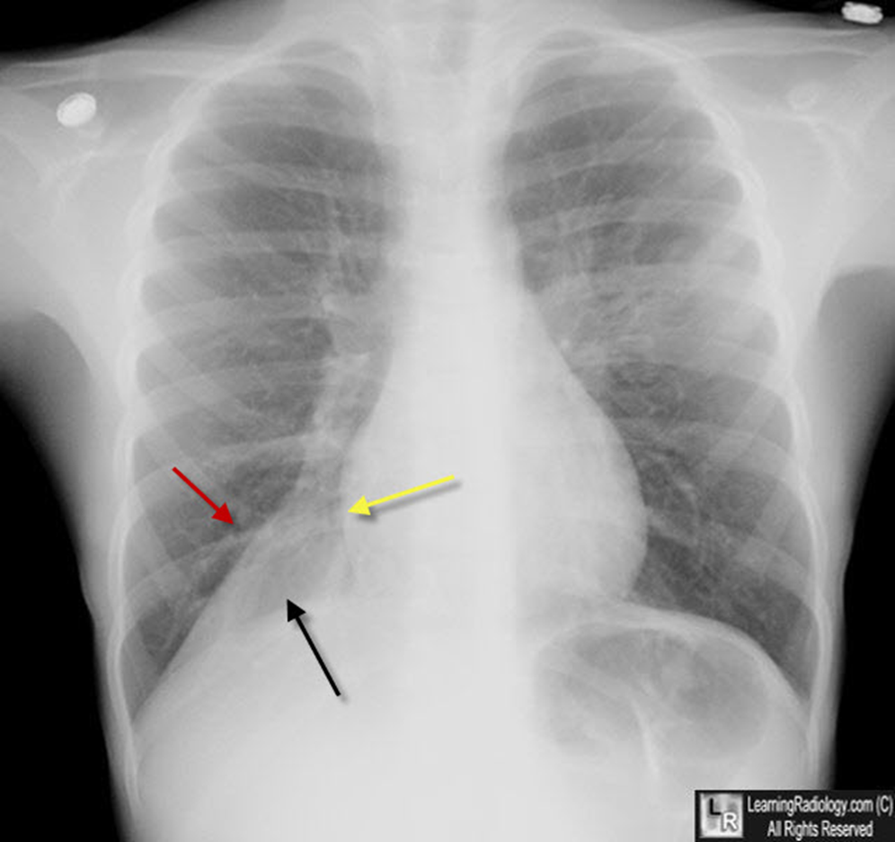
Notes:
there is a triangular or wedge-shaped density at the right lung base medially (black arrow) that displaces the major fissure inferiorly (red arrow), obscures the right hemidiaphragm and maintains the shadow of the right heart border (yellow arrow). The right hemithorax is filled by the overaerated right middle and upper lobes. The patient was an asthmatic and had a mucus plug in the RLL bronchus.

Slide 9
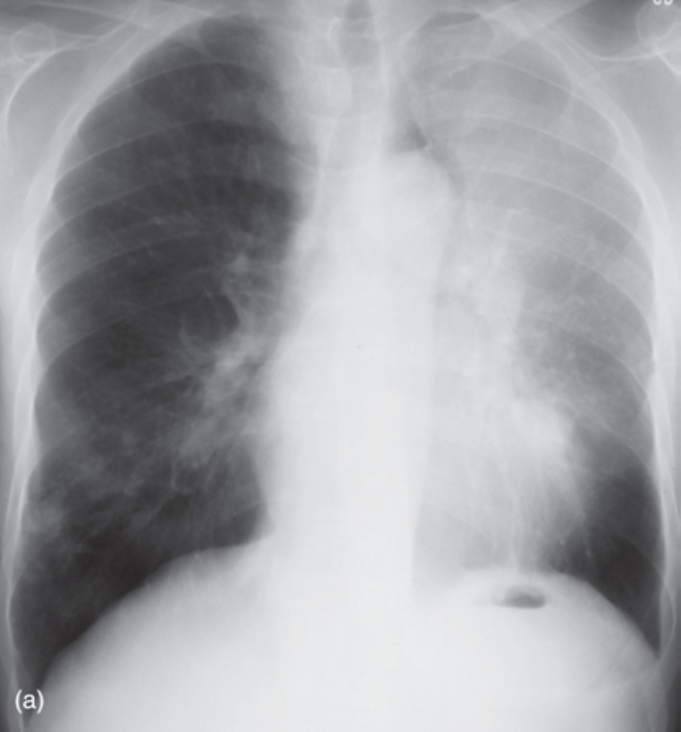
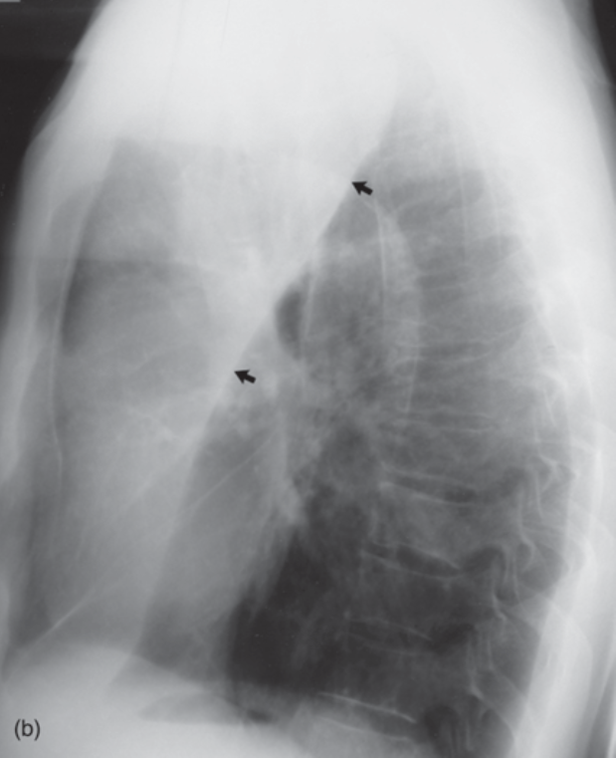

Slide 10
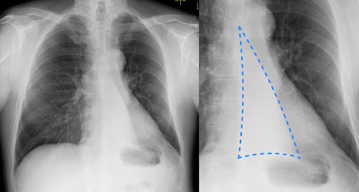

Slide 11
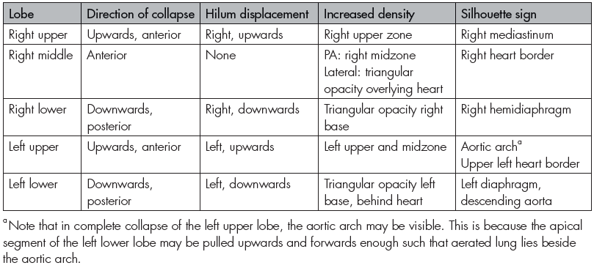

Slide 12
Solitary pulmonary nodule or mass
Solitary pulmonary nodule is defined as a spherical lung opacity seen on CXR or CT, measuring less than 3 cm diameter, and not associated with pulmonary collapse or lymphadenopathy.
Opacities larger than 3 cm are referred to as masses and are more likely to be malignant.
The aim of investigation and follow-up of pulmonary nodules is to diagnose those that are malignant, and to facilitate early resection.

Slide 13
Differential diagnosis of solitary pulmonary nodule
• Bronchogenic carcinoma
• Solitary metastasis
• Granuloma including tuberculoma
• Carcinoid tumor
• Arteriovenous malformation.
• Benign lung tumor: most commonly pulmonary hamartoma

Slide 14
Features associated with a higher likelihood of malignancy
• Evidence of rapid growth on serial CXR examinations
• Ill-defined margin
• Size >3 cm
• No calcification.

Slide 15
Features associated with a lower likelihood of malignancy
• Calcification
• Well-defined margin
• Small size (most granulomas measure 0.3–1.0 cm in diameter)
• Unchanged on serial CXR examinations.
Notes:
Findings on CXR that are sufficiently predictive of a benign aetiology to preclude further investigation are calcification and lack of growth over two years. Comparison with previous CXRs
is therefore essential, if these are available.

Slide 17
Imaging investigations
CT scan
FDG- PET
Biopsy
CT features suggestive of malignancy:
• Size >3 cm
• Spiculated (irregular) margin
• Contrast enhancement
• Other findings: lymphadenopathy, multiple lung lesions, liver metastases.

Slide 18
FDG-PET
May be useful to characterize solitary pulmonary nodules where other imaging is unhelpful.
Particularly useful for lesions that are not amenable to biopsy.
Neoplastic masses show increased uptake of FDG.
False-positive findings may occur in active inflammatory lesions.
FDG-PET is unable to accurately characterize lesions less than 1 cm in diameter.
Notes:
Lesions that have positive findings for malignancy on CT or FDG-PET usually require biopsy. Biopsy may be performed via bronchoscopy, percutaneously with CT guidance, with VATS, or by open surgical biopsy and resection.

Slide 19
Multiple pulmonary nodules
Differential diagnosis of multiple pulmonary nodules:
Granulomas
Metastases
Abscesses
Fungal infection: More common in immunocompromised patients, e.g., bone marrow transplant in children.
Hydatid cysts
Wegener’s granulomatosis
Multiple AVM
Notes:
commonly, multiple pulmonary nodules are seen in symptomatic patients, or in patients with underlying pathology, such as immunosuppression or malignancy.

Slide 20
Metastases
• Usually well defined
• Nodules of varying size
• More common peripherally and in the lower lobes
• Cavitation seen in squamous cell carcinomas, sarcomas and metastases from colonic primaries

Slide 21
Lung abscess
Lung abscesses are circumscribed collections of pus within the lungs. Usually, occurs from liquefactive necrosis of tissue.
It is either acute < 6 weeks or chronic.
primary abscess is one that develops as a result of a primary infection of the lung. These most commonly arise from aspiration, necrotizing pneumonia or chronic pneumonia, e.g., in the setting of pulmonary tuberculosis or immunodeficiency.
secondary abscess is one that develops as a result of another condition. Examples include:
bronchial obstruction: bronchogenic carcinoma, inhaled foreign body
hematogenous spread: bacterial endocarditis, intravenous drug use
direct extension from adjacent infection: mediastinum, subphrenic, chest wall

Slide 22
Imaging appearance
Plain radiograph
The classical appearance : is a cavity containing a gas-fluid level. In general, abscesses are round and appear similar in both frontal and lateral projections. Additionally, all margins are equally well seen, although adjacent consolidation may make the assessment of this difficult. cavities typically have a thick-wall (which may become thinner as the surrounding inflammation resolves) and smooth inner margin
CT SCAN
is the most sensitive and specific imaging modality to diagnose a lung abscess. Contrast should be administered, as this enables the identification of the abscess margins, which can otherwise blend with the surrounding consolidated lung.
Abscesses vary in size and are generally rounded in shape. They may contain only fluid or have a gas-fluid level. Typically, there is surrounding consolidation, although with treatment the cavity will persist longer than consolidation.

Slide 23
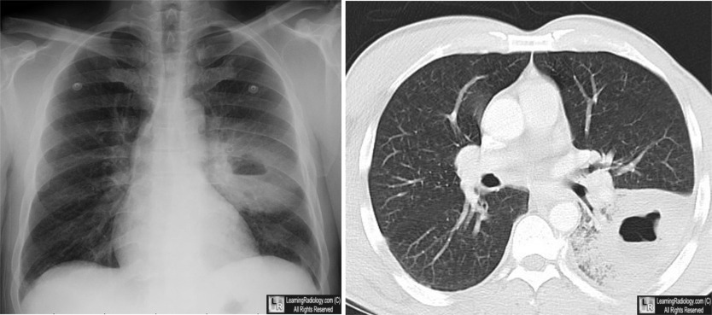

Slide 24
Hydatid cyst
Metazoal infestation caused by a tapeworm ( usually Echinococcus granulosus).
Cysts develop within the lungs (less commonly within the mediastinum) and are usually solitary, however 10% of cysts are multiple, bilateral, or associated with liver cysts.
At presentation 2/3 of cysts are ruptured (1/3 remain intact).

Slide 25
Radiological features
Unruptured pulmonary cysts
one or more homogenous roughly spherical or oval, sharply demarcated mass lesions (1-10cm)
occur particularly within the mid or lower lobes.
soft tissue density and almost never calcify.
They are easily deformed where they come up against any major bronchovascular structures: this leads to lobulation or eccentric contour or flattening of their peripheral aspect where they encounter chest wall or mediastinum.
They can also demonstrate changes in shape with breathing.
Notes:
Unlike their mediastinal counterpart.

Slide 26
Ruptured pulmonary cyst
If there is disruption of the inner layers a complex cavitary lesion results which can demonstrate an air fluid level or the following signs:
‘Double wall’ sign: ectocyst has separated from the pericyst
‘Water lily’ sign: a floating membrane
‘Rising sun’/‘serpent’ sign: an essentially dry cyst with crumpled membranes lying at its bottom
‘Empty cyst’ sign: a cyst with all its contents expectorated
* Rupture into the pleural space can cause an effusion or if there is additional airway communication a hydropneumothorax
Notes:
Cyst wall layers:
§ Pericyst: adventitia formed of compressed host lung tissue
§ Ectocyst: middle layer of friable tissue
§ Endocyst: inner germinal layer from which are produced the scolices

Slide 28
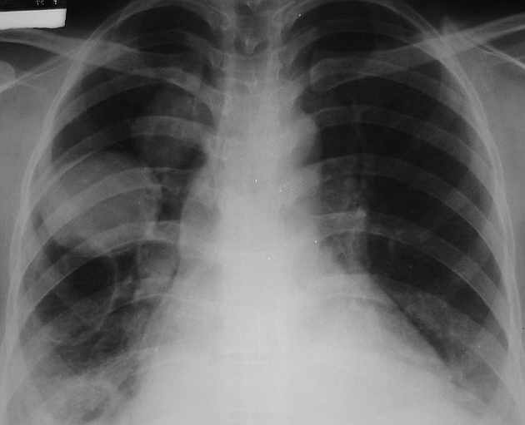

Slide 29
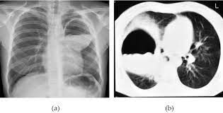

Slide 30
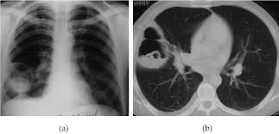

Slide 31
Mediastinal masses
Signs on CXR
Central opacity or mass
Continuity with the mediastinal outline
Sharp margin
Convex margin
Absence of air bronchograms
*** the differential diagnosis is based on localization to anterior, middle or posterior mediastinum.

Slide 32
Common causes of mediastinal masses
Intrathoracic thyroid masses (goiters): frequent cause of superior mediastinal mass and characteristically the mass extend to merge with soft tissue of neck, almost invariably compress or displace the trachea.
lymphadenopathy: any of the three compartments, possible to diagnose from their lobulated outline and the multiple location involved.
Neurogenic tumors: commonest cause of posterior mediastinal mass, pressure deformity of the adjacent ribs and thoracic spine is often visible.
Certain tumors such as dermoid cysts and thymoma are confined to anterior mediastinum.
Aneurysms of the aorta
Hiatus hernia: often contains air or a fluid level.

Slide 34
Hilar disorders
Each hilar complex as seen on the PA and lateral chest radiographs comprises the proximal pulmonary arteries, bronchus, pulmonary veins and lymph nodes.
Causes of unilateral hilar enlargement:
• Bronchial carcinoma
• Infective causes: • TB • Mycoplasma
• Perihilar pneumonia
• Other causes of lymphadenopathy (more commonly bilateral): • Lymphoma • Sarcoidosis
• Causes of enlargement of a single pulmonary artery: • Post-stenotic dilatation on the left side due to pulmonary stenosis • Massive unilateral pulmonary embolus • Pulmonary artery aneurysm
Notes:
Lymph nodes not seen unless enlarged
• An area of pneumonia lying anterior or posterior to the hilum may cause apparent hilar enlargement on the PA film
• Usually obvious on the lateral film

Slide 35
Causes of bilateral hilar enlargement:
• Bilateral pulmonary artery enlargement: pulmonary arterial hypertension
• Lymphoma : often asymmetrical
• Metastatic malignancy: bronchogenic carcinoma or non-pulmonary primary, e.g., testis
• Sarcoidosis

Slide 36
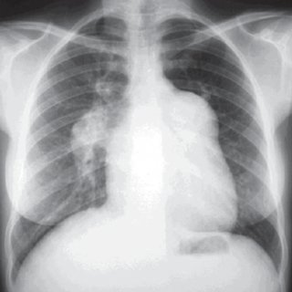

Slide 37
Pleural disorders
Include:
accumulation of fluid in the pleural spaces (pleural effusion).
air leaks (pneumothorax and pneumomediastinum).
pleural soft tissue thickening and plaque formation.

Slide 38
Pleural effusion
Refers to accumulation of fluid in the pleural space, between the visceral and parietal pleural layers.
The radiographic appearances of pleural effusion are generally the same regardless of the nature of the fluid, which may include transudate, exudate, blood, pus (empyema) or lymph (chylothorax).
Signs of pleural effusion on erect CXR:
• Homogeneous dense opacity at the base of the lung
• Concave upper surface higher laterally than medially, producing a meniscus
• Small pleural effusions produce blunting of the normal sharp angle between the lateral curve of the diaphragm and the inner chest wall, referred to as blunting of the costophrenic angle
• Large pleural effusions displace the mediastinum towards the contralateral side.
Notes:
The lateral view is more sensitive to the presence of small pleural effusions than the PA view. It is estimated that about 300 mL of fluid is required to show costophrenic angle blunting on the PA, whereas only 100 mL is required to produce this
sign (posteriorly) on the lateral view.

Slide 39
Causes of pleural effusion
• Cardiac failure: : bilateral pleural effusions, right usually larger than left
• Malignancy: bronchogenic carcinoma, metastatic, mesothelioma
• Infection: bacterial pneumonia, TB, mycoplasma, empyema, subphrenic abscess
• Pulmonary embolus with infarct
• Pancreatitis: effusion is usually left-sided
• Trauma: associated with rib fractures
• Connective tissue disorders: rheumatoid arthritis, SLE
• Liver failure
• Renal failure
• Meig’s syndrome: associated with ovarian tumor

Slide 41
Pneumothorax
refers to accumulation of air in the pleural space, between the visceral and parietal pleural layers.
Signs on CXR: lung edge outlined by air in the pleural space
Notes:
Expiratory scan more sensetive to small pneumothorax

Slide 42
Tension pneumothorax
Occurs with continued air leak from the lung into the pleural space.
This results in increased pressure in the pleural space with expansion of the hemithorax and further compression and collapse of the lung.
CXR signs of tension pneumothorax :
Marked collapse and distortion of the lung
Increased volume of hemithorax:
• Displacement of the mediastinum to the contralateral side
• Depressed diaphragm
• Increased space between the ribs.

Slide 43
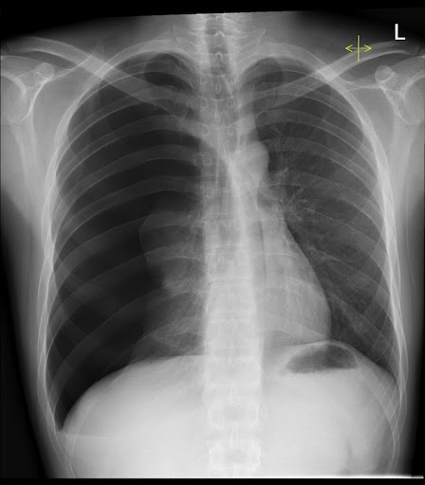

Slide 44
Signs of pneumothorax on a supine CXR:
• Mediastinal structures including heart border, inferior vena cava (IVC), SVC are sharply
outlined by adjacent free pleural air
• Upper abdomen appears lucent due to overlying air
• Deep lateral costophrenic angle.
Notes:
Supine AP CXR may have to be performed in ICU patients or following severe trauma. Pleural air lays anteromedially and beneath the lung so that the usual appearance of a pneumothorax as described for an erect PA film is not seen.

Slide 45
Causes of pneumothorax
• Spontaneous: tall, thin males, smokers
• Iatrogenic: percutaneous lung biopsy, complication of ventilation, central venous pressure (CVP) line or cardiac pacemaker insertion
• Trauma: associated with rib fractures
• Emphysema
• Malignancy: high incidence with osteogenic sarcoma metastases
• Honeycomb lung
• Lymphangiomyomatosis (LAM): interstitial disease of young women
• Cystic fibrosis.

Slide 46
A 26-year-old woman with malaise and night sweats.
Notes:
Posteroanterior chest radiograph shows lateralization of the AP reflection, convexity in the AP window, widening of the right paratracheal stripe, and convexity of the azygoesophageal recess. These findings indicate prevascular (anterior mediastinal), AP window, right paratracheal, and subcarinal lymphadenopathy.
Left lateral chest radiograph confirms increased soft tissue density in the anterior mediastinum and subcarinal

Slide 47
DIAGNOSIS: Hodgkin’s lymphoma
Notes:
Contrast-enhanced chest CT (mediastinal window) reveals a conglomerate, lobular anterior mediastinal mass with minimal enhancement.
Contrast-enhanced chest CT (mediastinal window) also reveals enlarged subcarinal and right hilar lymph nodes.

Slide 48
